Slide 1



Harnessing Data Insights for Proactive Security
By : Madhavi Ghanta
Date : 04/02/2024
DSC680 Applied Data Science
Notes:
Hi Everyone, I am Madhavi Ghanta and today, we'll examine the crucial area of credit card transaction security and the measures we're doing to protect people's financial stability.

Slide 2
INTRODUCTION
The persistent rise in credit card fraud has been a serious problem for financial institutions and businesses worldwide. We are forced by this overwhelming problem to investigate practical solutions that are able to both detect and stop fraudulent transactions in real time.
With the help of machine learning, this research aims to build a reliable credit card fraud prediction system. The main goal of this system is to distinguish between authentic and fraudulent credit card transactions.
Notes:
Today, credit card theft is a persistent threat that is hurting businesses all over the world. This difficulty forces us to look for creative solutions that can instantly identify and stop fraudulent transactions. By using machine learning to create a reliable credit card fraud prediction system, this project sets off on a revolutionary path. Making a distinct distinction between authentic and fraudulent credit card transactions is the main goal.
By doing this, we hope to accomplish a number of vital objectives, including strengthening security protocols, lowering false positives that could unnecessarily annoy consumers, improving the general customer experience, and—above all—keeping a step ahead of the constantly changing strategies used by fraudsters.

Slide 3
PROCESS
The process flow of this project is as follows:
Data Preparation
(Cleansing & Transformation)
Data Collection
Exploratory Data Analysis
Model Building and Training
Model Evaluation
Notes:
This slide outlines the project process flow. We'll delve into each step in upcoming slides.

Slide 4
DATA SOURCE (Collection)
The dataset used in this project is sourced from Kaggle by
Shenoy, K. (2020, August 5)), a public-domain dataset.
This dataset contains stimulated credit card data with legitimate and fraudulent credit card transactions from Jan 2019 to Dec 2020.
Notes:
The project's dataset comes from Kaggle. It contains fictitious credit card data with attributes such transaction amounts, timestamps, merchant information, geographic data, and cardholder information, showcasing both authentic and fraudulent transactions.

Slide 5
DATA PREPARATION
The following steps were performed to prepare the data for modelling.
i. Checked for null rows/columns in the data.
ii. Performed check for duplicates.
iii. Converted datetime string to a datetime datatype.
iv. Added a month column for visualization.
v. Dropped columns (‘Unnamed: 0' and 'trans_date_trans_time’)
Notes:
Here, we can observe the various data preparation procedures that the project has used. Checks for things like duplicate rows, empty rows, datetime conversions, etc. are done throughout specific data transformation processes.

Slide 6
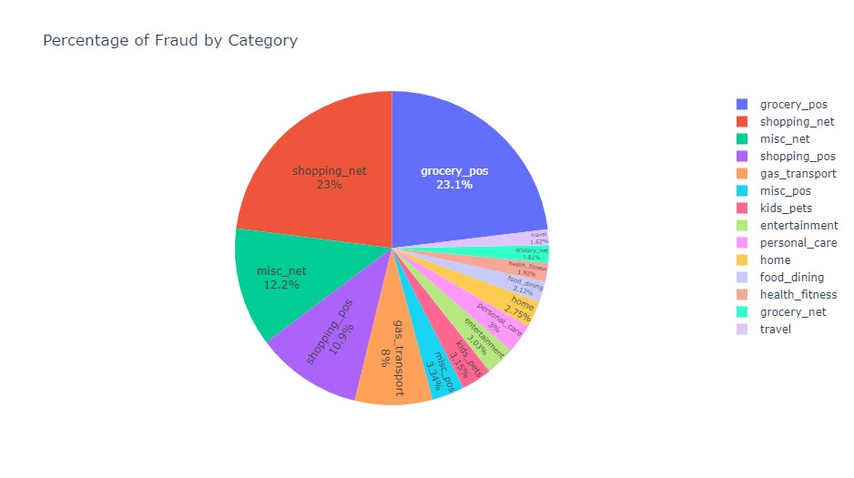
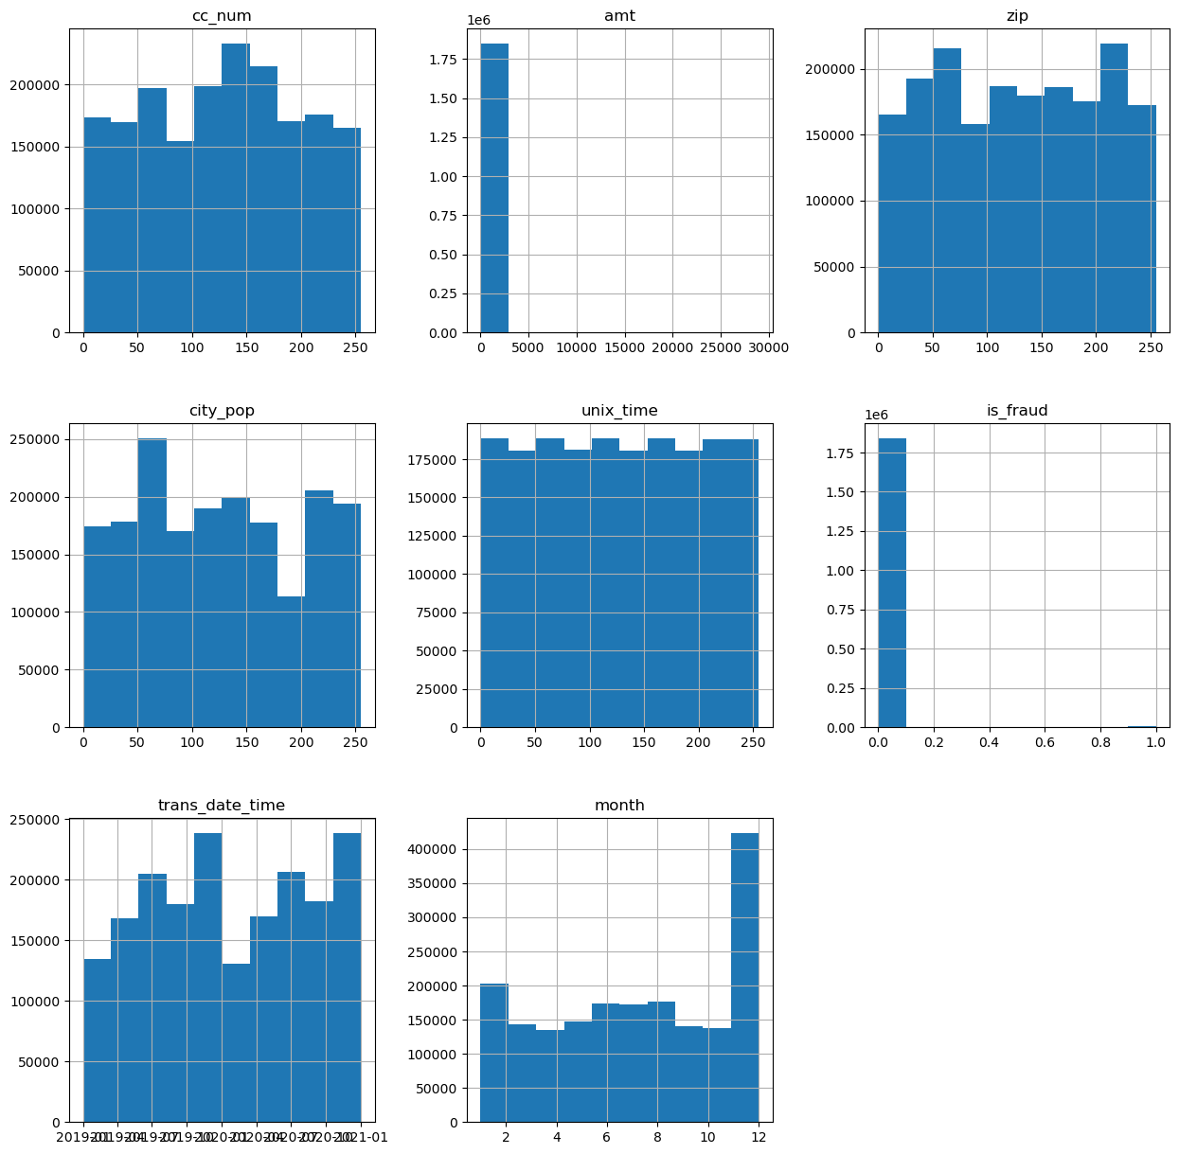
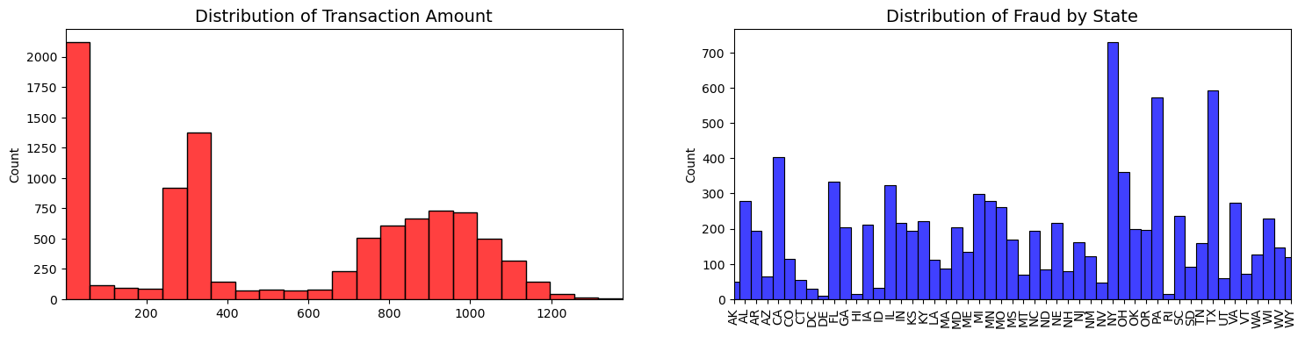
EXPLORATORY DATA ANALYSIS
Notes:
This slide showcases various visualizations created from our dataset.
A pie chart illustrating frauds by category.
A chart displaying the distribution of transaction amounts and the number of frauds per state.
The third visualization showcases the distribution of numeric fields in the dataset."

Slide 7
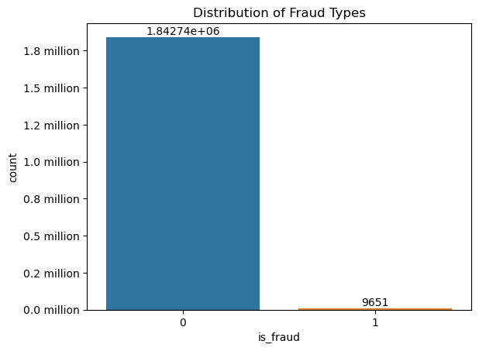
MODEL BUILDING & TRAINING
To construct an effective model, it is essential to address the dataset's imbalance. To achieve this, the Synthetic Minority Oversampling Technique (SMOTE) was employed. With the balanced dataset, the subsequent step was to partition the data into training and testing datasets.
Notes:
There was an initial class imbalance, with more non-fraud transactions than fraudulent ones, reflecting real-time scenarios. To address the imbalance, the Synthetic Minority Oversampling Technique (SMOTE) was employed to balance the dataset.
Additionally, given the dataset's categorical features, a Label Encoder was utilized to convert them into numerical format, and the StandardScaler preprocessing technique was applied to standardize or normalize numerical features.

Slide 8
The following models were developed, with their respective outcomes recorded.
Random Forest Classifier
Using a Random Forest model for credit card fraud detection offers benefits like ensemble learning, robustness against noise and outliers, handling imbalanced data, and capturing complex patterns. Its ability to handle non-linearity, easy tunability, and feature importance analysis make it a strong choice.
Pros: Ensemble learning, robustness, handles imbalanced data, captures complex patterns.
Logistic Regression
Using a Logistic Regression model for credit card fraud detection has benefits including interpretability, computational efficiency, and suitability for smaller datasets. It provides insights into feature impacts, acts as a baseline, and offers transparent probability estimations. However, its linear nature might limit performance on complex, non-linear data patterns.
Pros: Interpretable, efficient, suitable for smaller datasets.
Cons: Limited performance on complex, non-linear data.
Gradient Booster
Gradient Boosting is a powerful method for credit card fraud detection due to its high predictive accuracy, ensemble nature that reduces overfitting, and the ability to handle complex patterns in the data. It also offers insights into feature importance, aiding in identifying relevant variables for fraud detection.
Pros: High predictive accuracy, reduces overfitting, handles complex data patterns.
Neural Network
Neural Network (NN) models offer advantages in credit card fraud detection due to their ability to capture intricate non-linear patterns in data. They excel in feature learning from raw data, making them adept at detecting complex and evolving fraud behaviors.
Pros: Captures intricate non-linear patterns, adept at detecting complex fraud behaviors.
Notes:
In this project, we built the Random Forest Classifier, Logistic Regression, Gradient Booster, and Neural Network models. This slide presents an overview of each model and its advantages and disadvantages. We'll delve into the outcomes of each model in the upcoming slides.

Slide 9
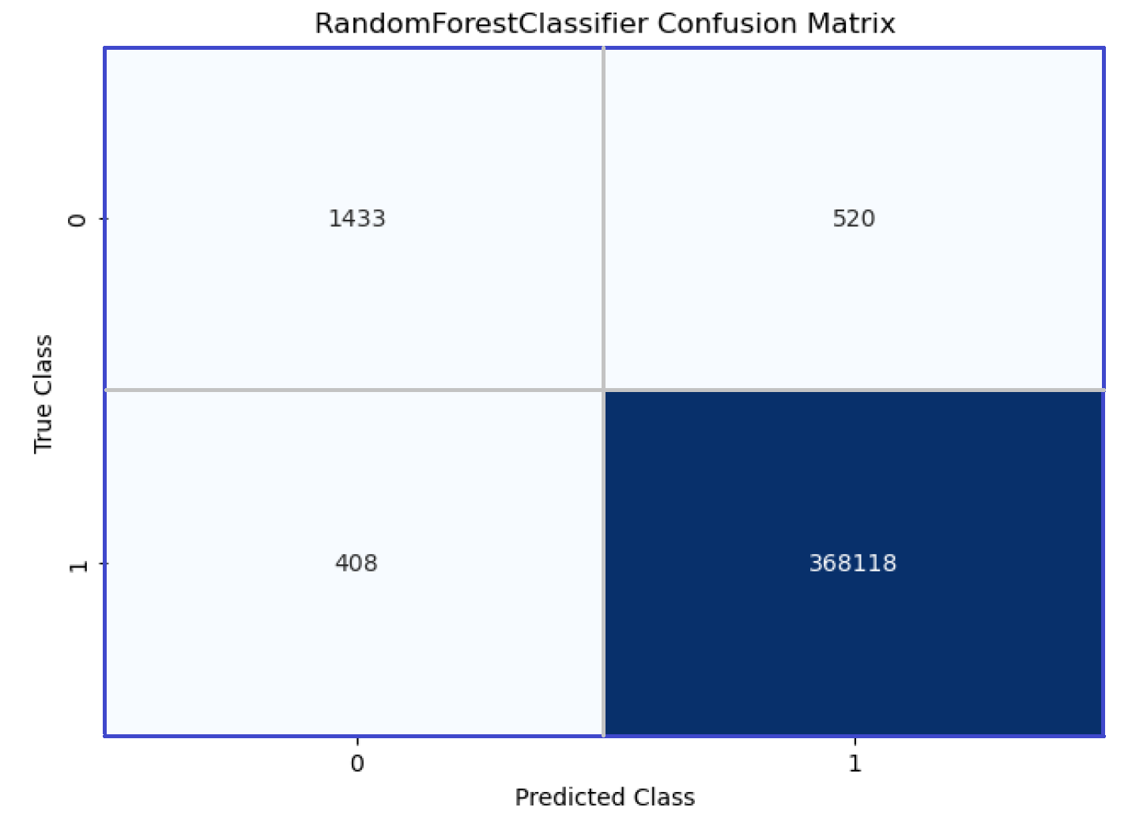
MODEL EVALUATION
Random Forest Classifier
Fraud Type | Precision | Recall | F1-Score
0 – non-Fraud | 1.00 | 1.00 | 1.00
1 - Fraud | 0.79 | 0.72 | 0.75
Accuracy | ROC-AUC Score
99.75% | 0.86
Notes:
Random Forest Classifier:
Based on the recall, we can say that the model correctly identifies 72% of actual fraud cases.
A ROC-AUC score of 0.86 suggests that the model has a strong ability to discriminate between non-fraudulent and fraudulent transactions.
The confusion matrix provides a detailed breakdown of the model's predictions. It shows that the model correctly classified 368,118 non-fraudulent transactions (True Negatives) and 1,433 fraudulent transactions (True Positives). It also misclassified 408 non-fraudulent transactions as fraudulent (False Positives) and 520 fraudulent transactions as non-fraudulent (False Negatives).

Slide 10
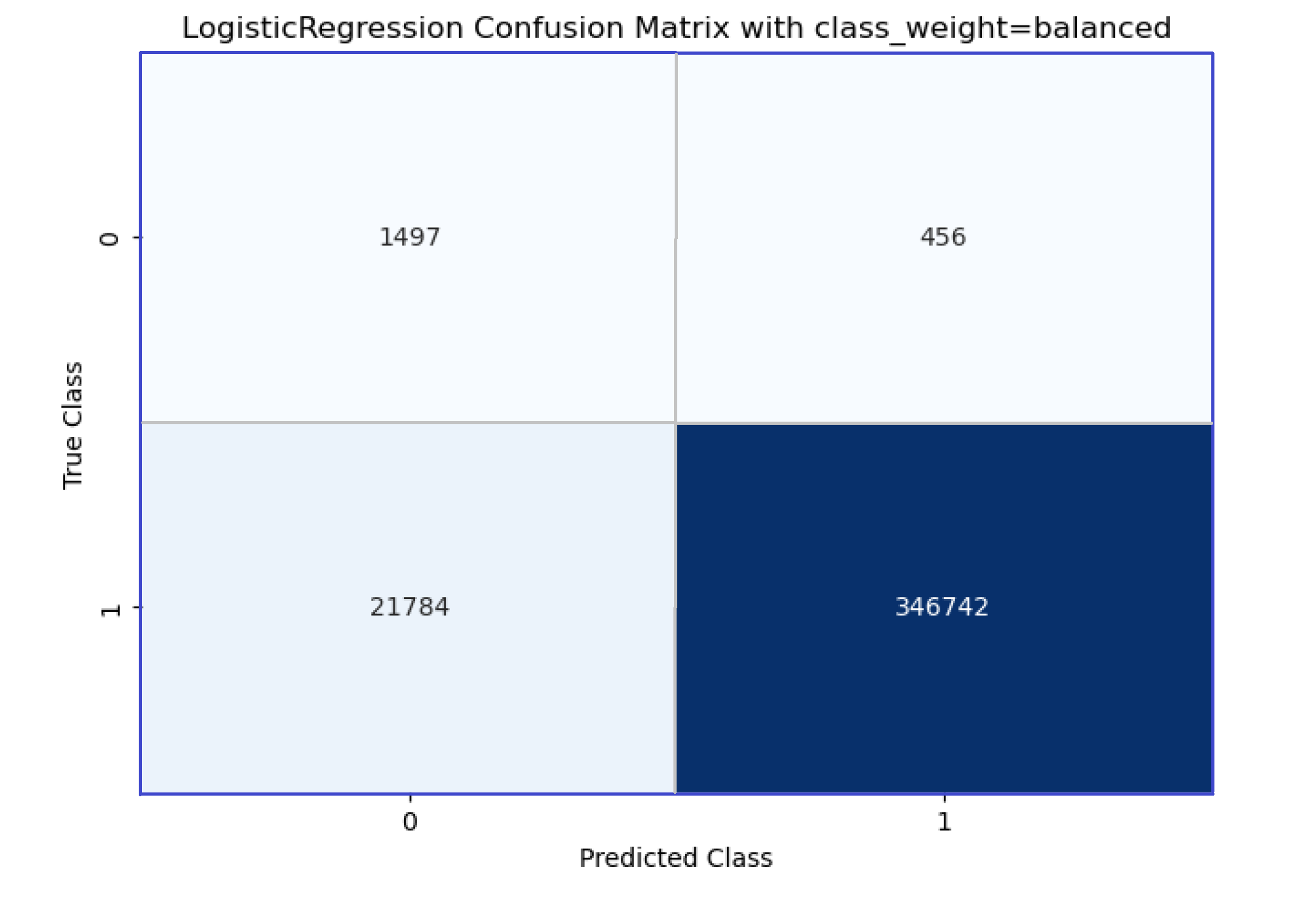
Logistic Regression
Fraud Type | Precision | Recall | F1-Score
0 – non-Fraud | 1.00 | 0.94 | 0.97
1 - Fraud | 0.06 | 0.77 | 0.12
Accuracy | ROC-AUC Score
93.99% | 0.85
Notes:
Logistic Regression:
The Logistic Regression model correctly identifies about 94% of all actual non-fraudulent transactions and 77% of actual fraud cases.
A ROC-AUC score of 0.85 indicates a relatively good ability to discriminate between non-fraudulent and fraudulent transactions.
Confusion Matrix:
The confusion matrix shows that the model correctly classified 346,742 non-fraudulent transactions (True Negatives) and 1,497 fraudulent transactions (True Positives). However, it also misclassified 21,784 non-fraudulent transactions as fraudulent (False Positives) and 456 fraudulent transactions as non-fraudulent (False Negatives).

Slide 11
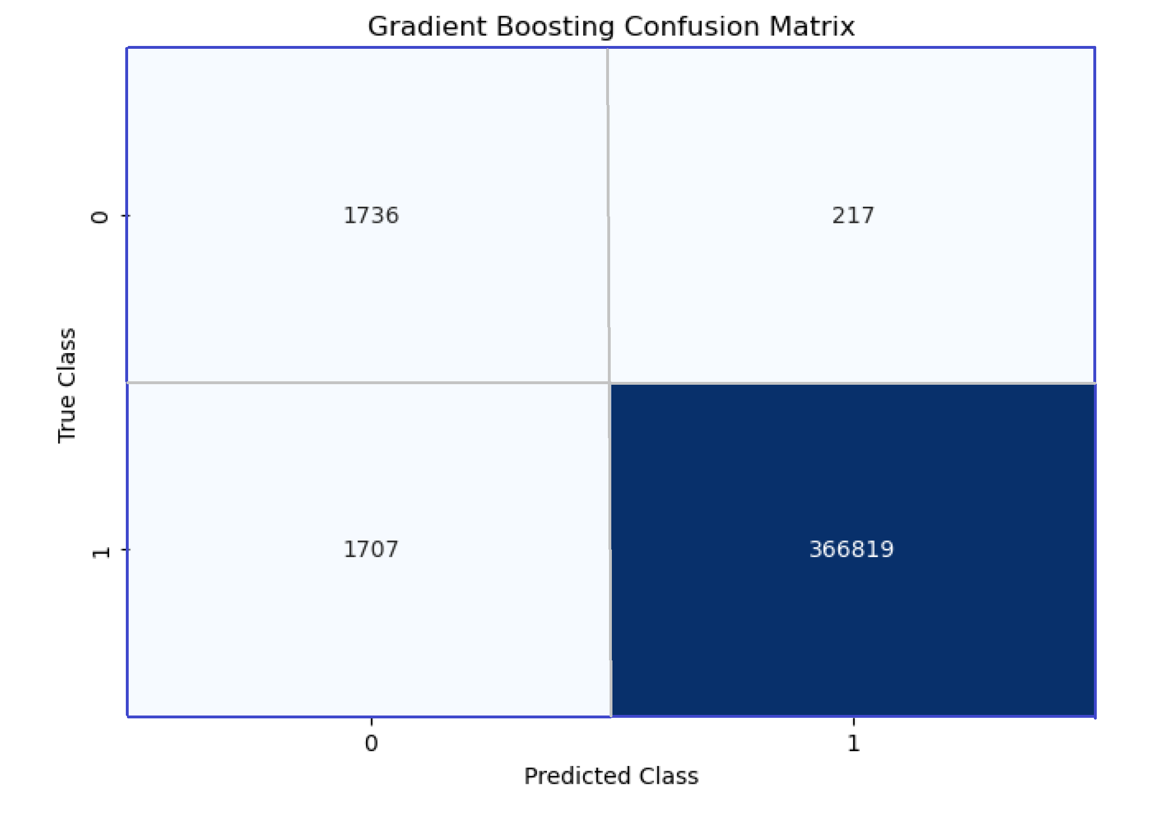
Gradient Boosting
Fraud Type | Precision | Recall | F1-Score
0 – non-Fraud | 1.00 | 1.00 | 1.00
1 - Fraud | 0.50 | 0.89 | 0.64
Accuracy | ROC-AUC Score
99.4% | 0.94
Notes:
Gradient Boosting:
The model correctly identifies about 89% of all actual fraud cases.
A ROC-AUC score of 0.94 is excellent and indicates a strong ability to discriminate between non-fraudulent and fraudulent transactions.
The confusion matrix shows that the model correctly classified 366,819 non-fraudulent transactions (True Negatives) and 1,736 fraudulent transactions (True Positives). It misclassified 1,707 non-fraudulent transactions as fraudulent (False Positives) and 217 fraudulent transactions as non-fraudulent (False Negatives).

Slide 12
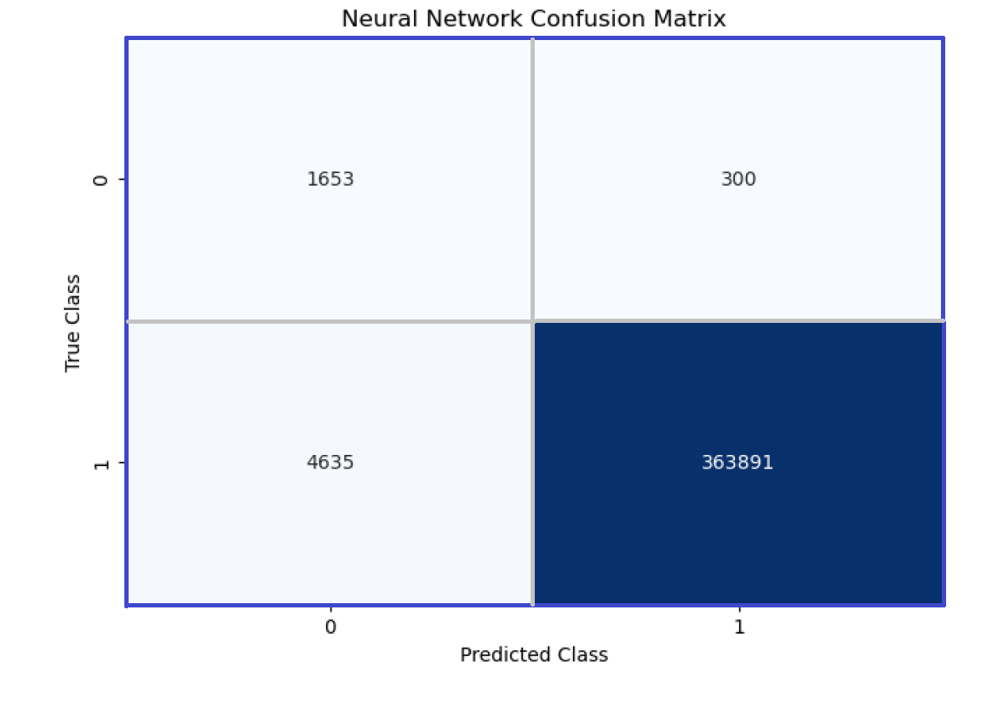
Neural Network
Fraud Type | Precision | Recall | F1-Score
0 – non-Fraud | 1.00 | 0.99 | 0.99
1 - Fraud | 0.26 | 0.75 | 0.38
Accuracy | ROC-AUC Score
98.7% | 0.87
Notes:
Neural Network:
The model correctly identifies about 75% of all actual fraud cases.
A ROC-AUC score of 0.87 is good and indicates a reasonable ability to discriminate between non-fraudulent and fraudulent transactions.
The confusion matrix shows that the model correctly classified 363,891 non-fraudulent transactions (True Negatives) and 1,653 fraudulent transactions (True Positives). However, it also misclassified 4,635 non-fraudulent transactions as fraudulent (False Positives) and 300 fraudulent transactions as non-fraudulent (False Negatives).

Slide 13
ETHICAL IMPLICATIONS
Several ethical considerations are crucial for this project:
Data Privacy: Despite the simulation, safeguarding privacy is essential. Ensuring simulated data does not resemble real customer information avoids accidental exposure of PII (Appendix (i)).
Informed Consent: Transparency builds trust and addresses concerns. Understanding if consent was obtained for real-based simulations, even if anonymized, adds ethical integrity.
Intent and Use: Ethical utilization of simulated data is paramount, prohibiting any malicious or harmful intent.
Data Security: Robust security measures should be applied to the simulated dataset, treating it with the same importance as real customer data.
Stakeholder Implications: The viewpoints of stakeholders like credit card issuers, customers, and regulators to ensure ethical alignment should be considered.
Notes:
ETHICAL IMPLICATIONS:
It is crucial to take ethical considerations like data privacy, transparency, and security into account while working with credit card data. It is crucial to use simulated data constructively and without malice. Engaging with stakeholders actively is also crucial to ensuring that expectations and ethical standards are met.

Slide 14
CONCLUSION
In conclusion, our journey to fight credit card fraud has been enlightening. We explored various machine-learning techniques to build robust fraud detection systems.
The Random Forest Classifier performed best with an impressive 99.75% accuracy.
Model | Random Forest Classifier | Logistic Regression | Gradient Booster | Neural Network
Accuracy | 99.75% | 93.99% | 99.4% | 98.7%
Notes:
CONCLUSION:
In summary, this project focused on developing and implementing effective credit card fraud detection models. We explored various machine-learning techniques, such as logistic regression, random forest classifier, gradient boosting, and neural networks.
With an accuracy of 99.75%, the Random Forest Classifier is the best-performing model for this dataset. However, the dataset is highly imbalanced, with a significantly larger number of non-fraudulent transactions. This can impact the model's performance and interpretation of metrics.
While all three models demonstrated high accuracy and strong performance in identifying non-fraudulent transactions, there is a trade-off between precision and recall for detecting fraudulent transactions.

Slide 15
REFERENCES
Shenoy, K. (2020, August 5). Credit Card Transactions Fraud Detection Dataset.
Kaggle - https://www.kaggle.com/datasets/kartik2112/fraud-detection?select=fraudTrain.csv
Jennifer Watkins, ARC’s Director, Credit Card Services & Fraud Prevention, and Christophe Kato, IATA’s Head of Payment Services. (2020, August 5). Credit Card Transactions Fraud Detection Dataset. (2018, September 3)
Preventing credit card fraud can reduce chargeback ADMs - https://airlines.iata.org/sites/default/files/migrated/airlines/airlines/analysis-preventing-credit-card-fraud-ca--web-fraud-prevention-istock-155354133-20.png

Slide 16
THANK YOU!
Notes:
Thank you all for joining me in this presentation. I hope this project was able to help in the understanding of the efforts to enhance credit card transaction security. If you have any questions or insights, please feel free to share them. Thank you.

